Slide 1
Congressional Term Limits
January 2021

Slide 2
Purpose and Methodology
An online survey study was completed in order to assess opinions about term limits for members of the U.S. Congress.
Panelists from our Iowa Opinion Panel (IOP) were polled in December 2020.
A total of 1,940 IOP members residing in Iowa and adjacent states completed the survey.
The results were examined regarding age, gender, income, education, and political party differences.
There were no differences by age.
Differences for the other variables were not large – about one term limit.
▼ 2

Slide 3
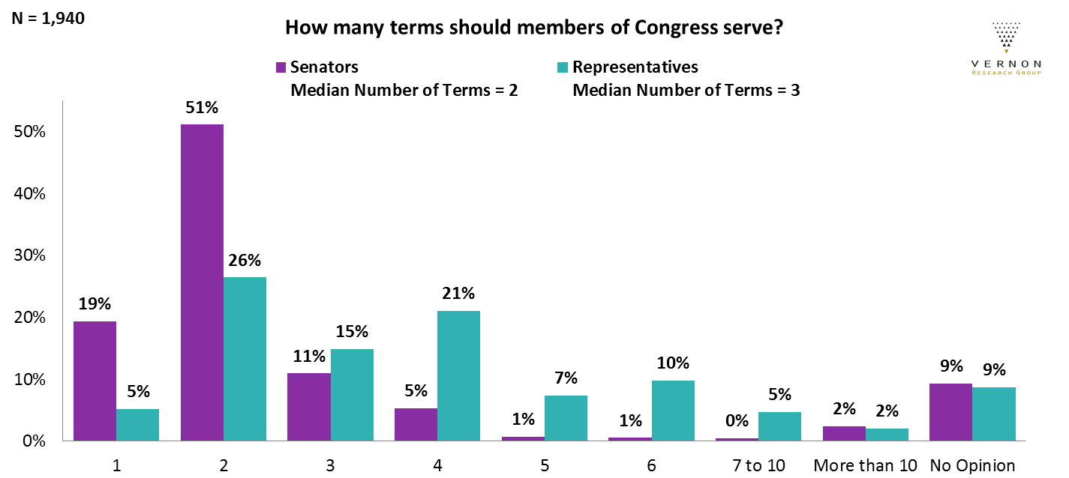
Term Limits
Although senators have terms that last three times longer than those of representatives,
IOP members don't believe representatives should have three times as many terms to serve.
Most felt fewer than five terms for either position is enough.
▼ 3

Slide 4
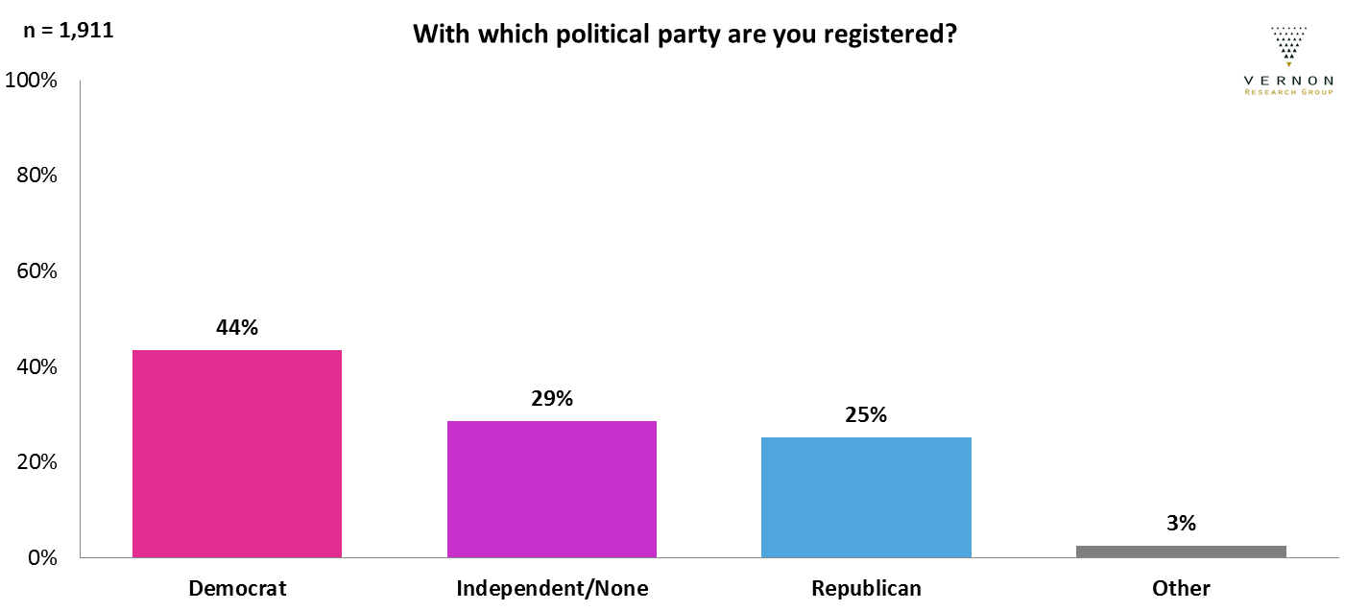
Political Party
IOP members who responded to this survey were more likely to be Democrats.
▼ 4
Notes:
Data on political party was not available for all survey participants.

Slide 5
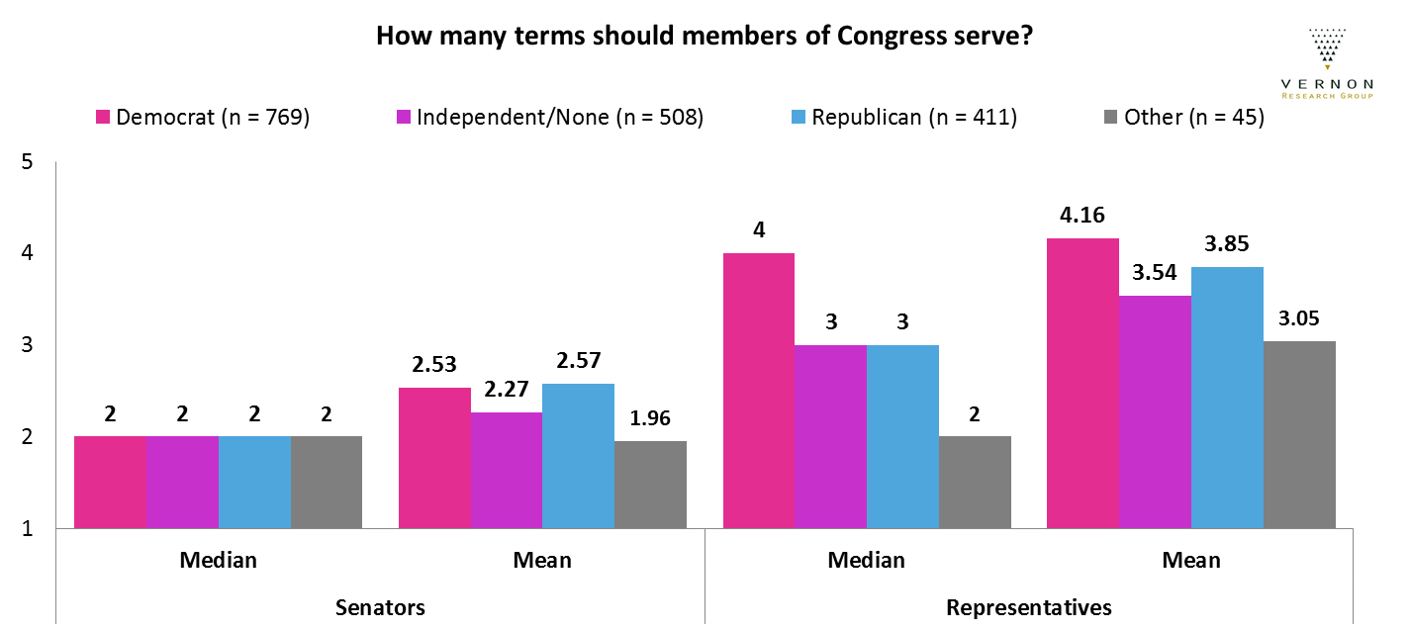
Term Limits by Political Party
All groups felt similarly about senators, but Democrats would prefer higher term limits for representatives than other parties prefer.
▼ 5

Slide 6
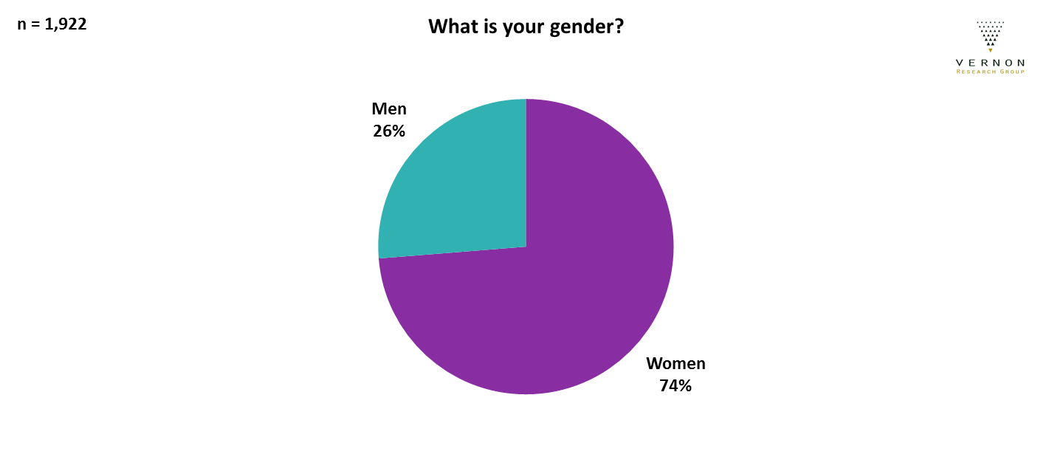
Gender
Most IOP members are women. This is consistent with other panels and survey results.
▼ 6
Notes:
Data on gender was not available for all survey participants.
Non-binary participants are not shown on this chart because they were not included in the data cut. They were not included in the data cut because there were so few of them.

Slide 7
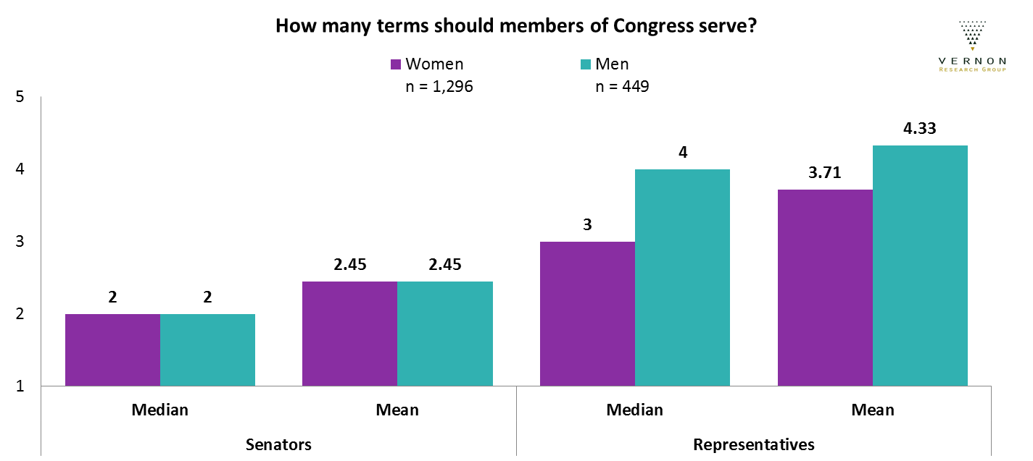
Term Limits by Gender
Women and men feel similarly about the number of terms senators should have, but women would limit representatives' number of terms more than men would by about 1 term (2 years).
▼ 7

Slide 8
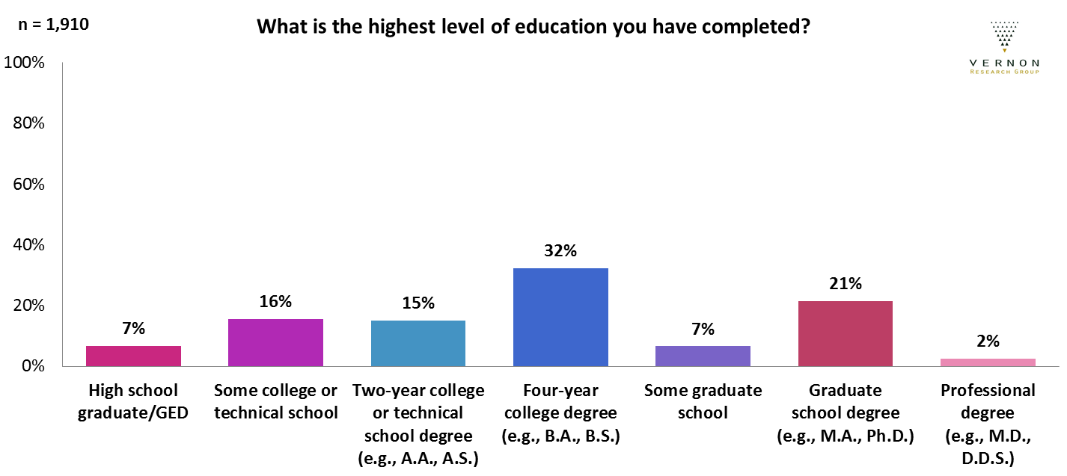
Education Level
37% of respondents had less than a college degree, 32% had a college degree,
and 30% had education beyond a college degree.
▼ 8
Notes:
Data on education level was not available for all survey participants. Some data rounding is causing the differences when you add percentages.
Those with less then a high school degree are not included in this chart because they are not included in the data cut. They were not included in the data cut because there were so few of them.

Slide 9
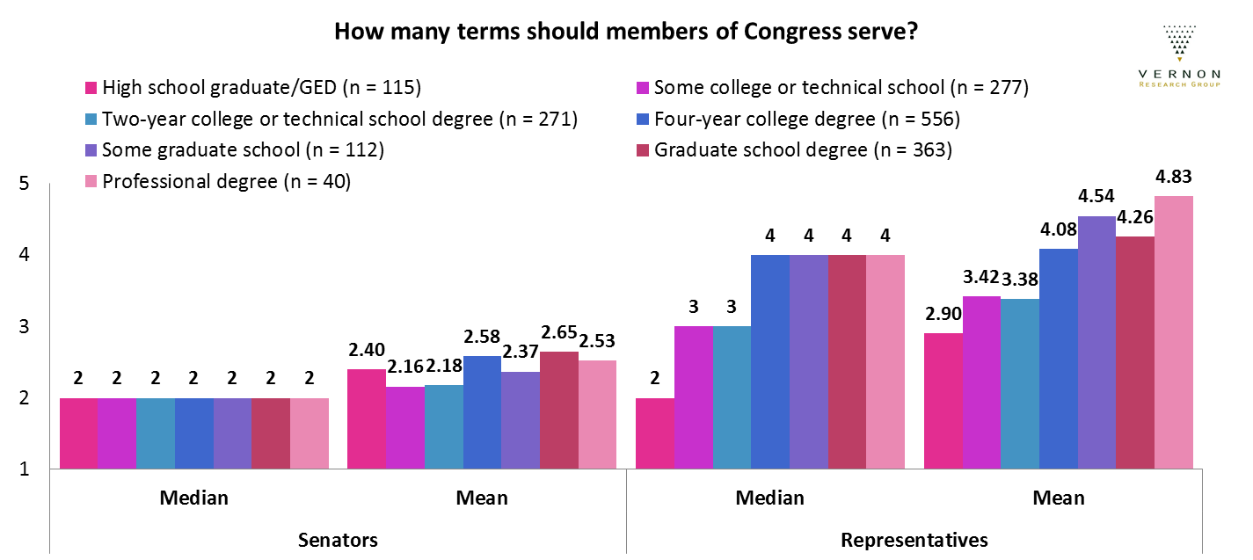
Term Limits by Education Level
All groups felt similarly about senators, but as amount of formal education increased,
people increased the number of terms they would prefer for representatives.
▼ 9

Slide 10
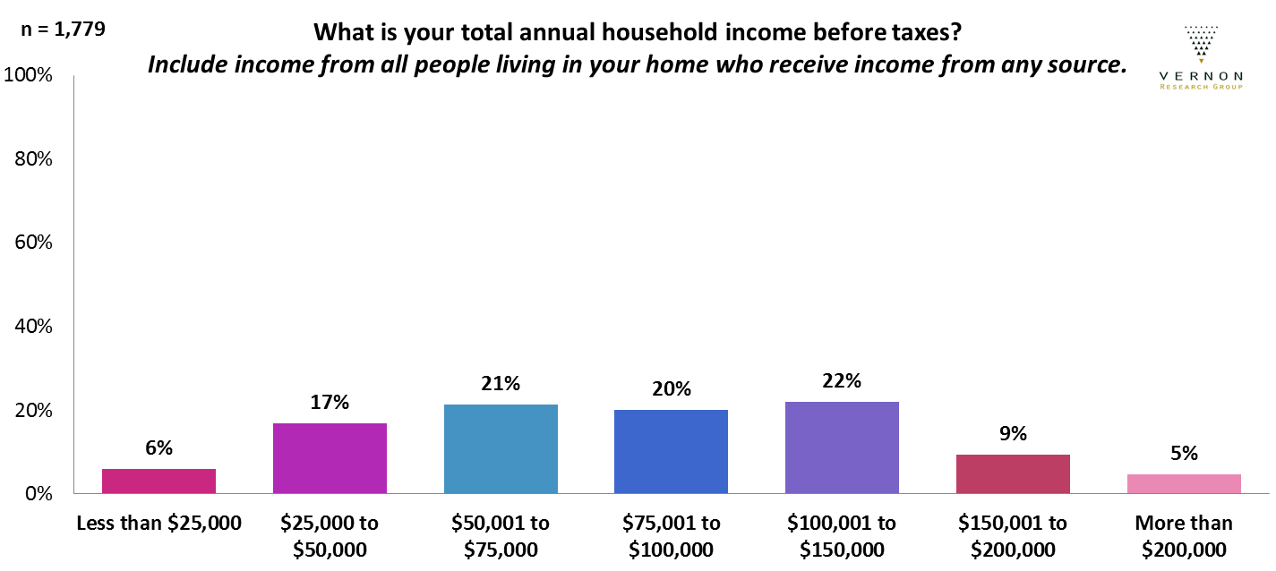
Household Income
The sample has a lower proportion of participants in the lowest income category and higher proportions in the categories over $75,000, compared to the larger population of voters in Iowa.
▼ 10
Notes:
Data on household income was not available for all survey participants.

Slide 11
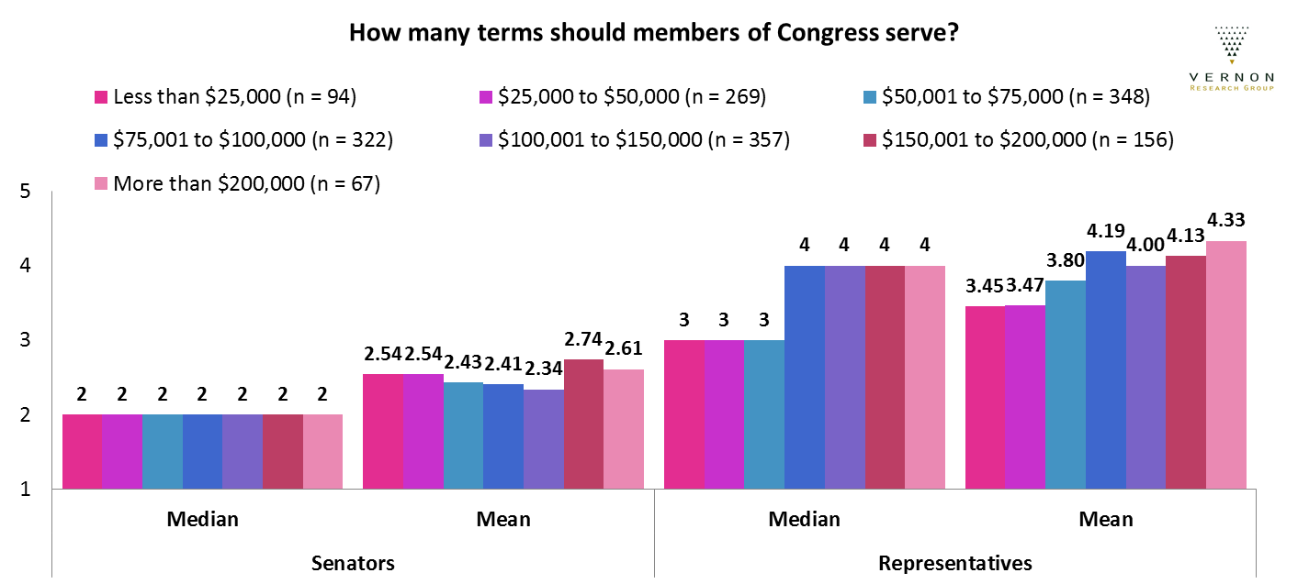
Term Limits by Household Income
All groups felt similarly about senators, but as income increased,
people increased the number of terms they would prefer for representatives.
▼ 11

