Slide 1
November 3, 2020, Election Participation
December 2020

Slide 2
Purpose and Methodology
An online survey study was completed in order to assess participation rates in the November 3, 2020, presidential election.
Panelists from our Iowa Opinion Panel (IOP) were polled in November 2020 after November 3.
A total of 1,404 IOP members residing in Iowa and adjacent states completed the survey.
▼ 2

Slide 3
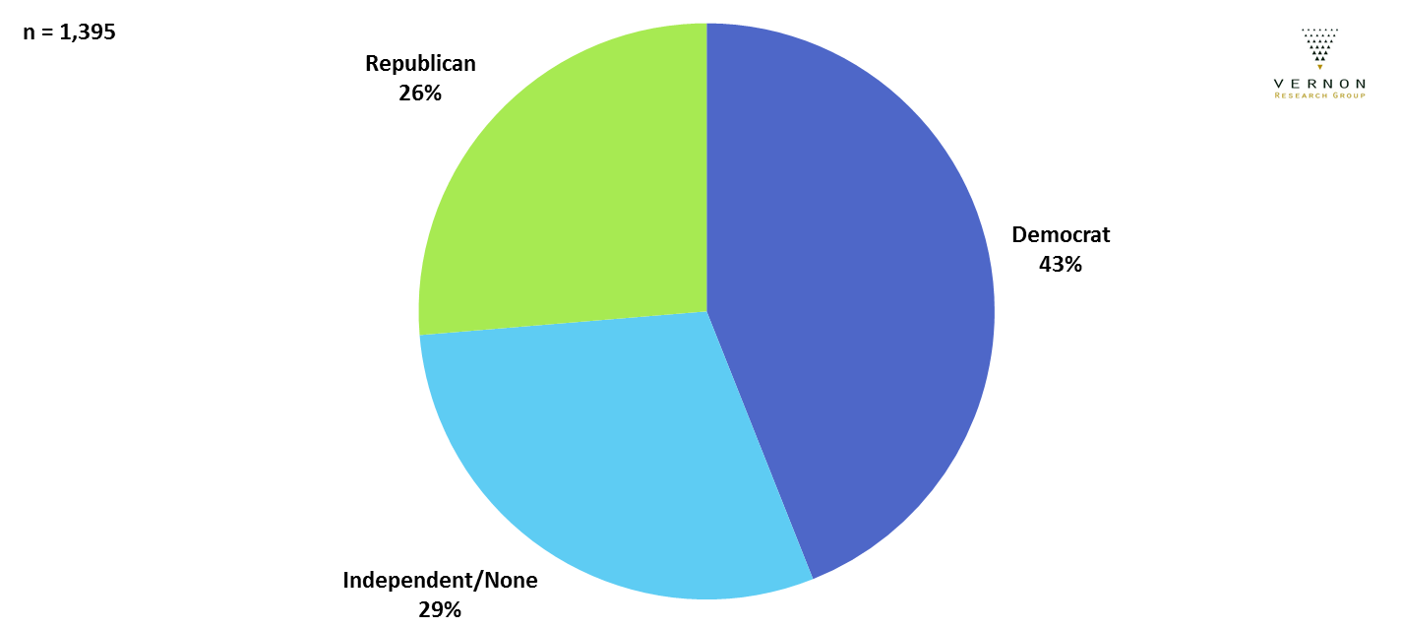
Political Party
IOP members who responded to this survey were somewhat more likely to be Democrats.
▼ 3
Notes:
Data on political party was not available for all survey participants.

Slide 4
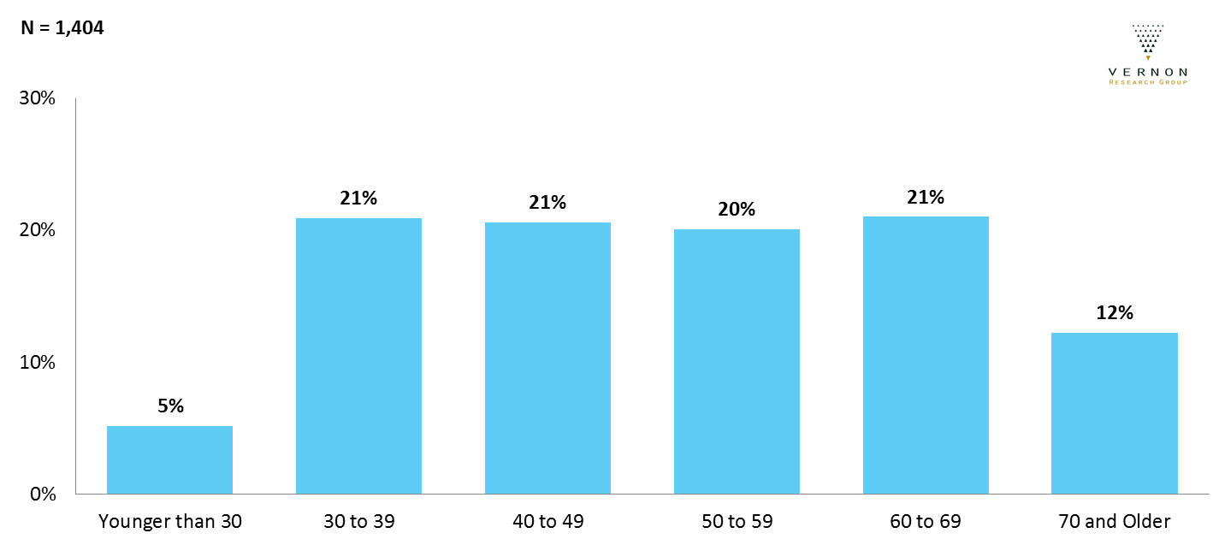
Age
The makeup of the IOP is distributed evenly among most age groups.
▼ 4

Slide 5
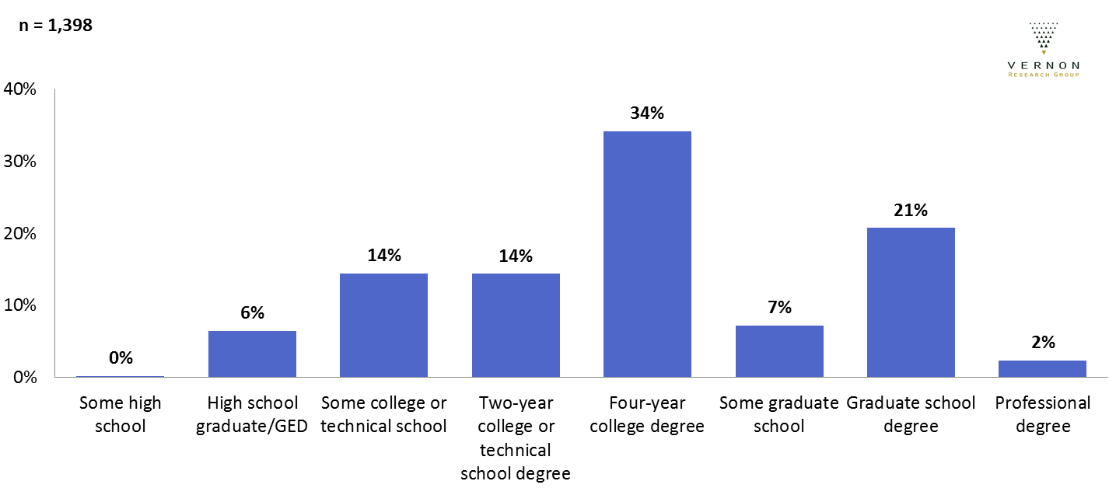
Education Level
35% of respondents had less than a college degree, 34% had a college degree,
and 30% had education beyond a college degree.
▼ 5
Notes:
Data on education level was not available for all survey participants. Some data rounding is causing the differences when you add percentages.

Slide 6
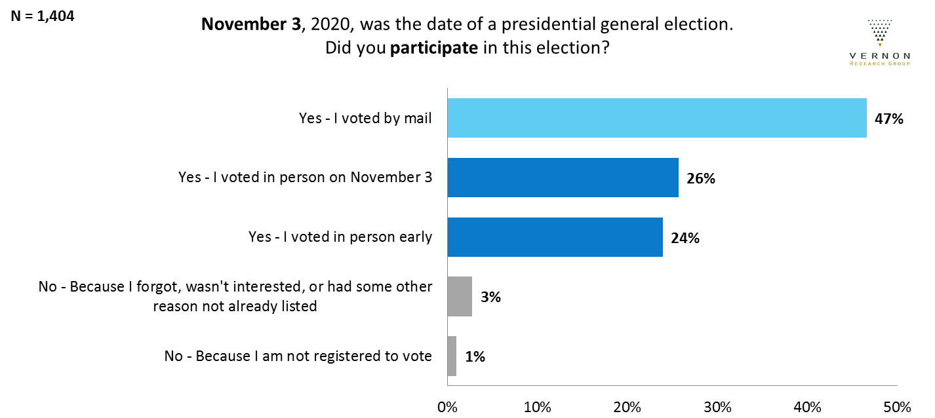
Election Participation
96% of IOP members voted on November 3.
There were nearly as many who voted by mail as voted in person (either early or on November 3).
1% of voters had never voted in a presidential election before.
▼ 6

Slide 7
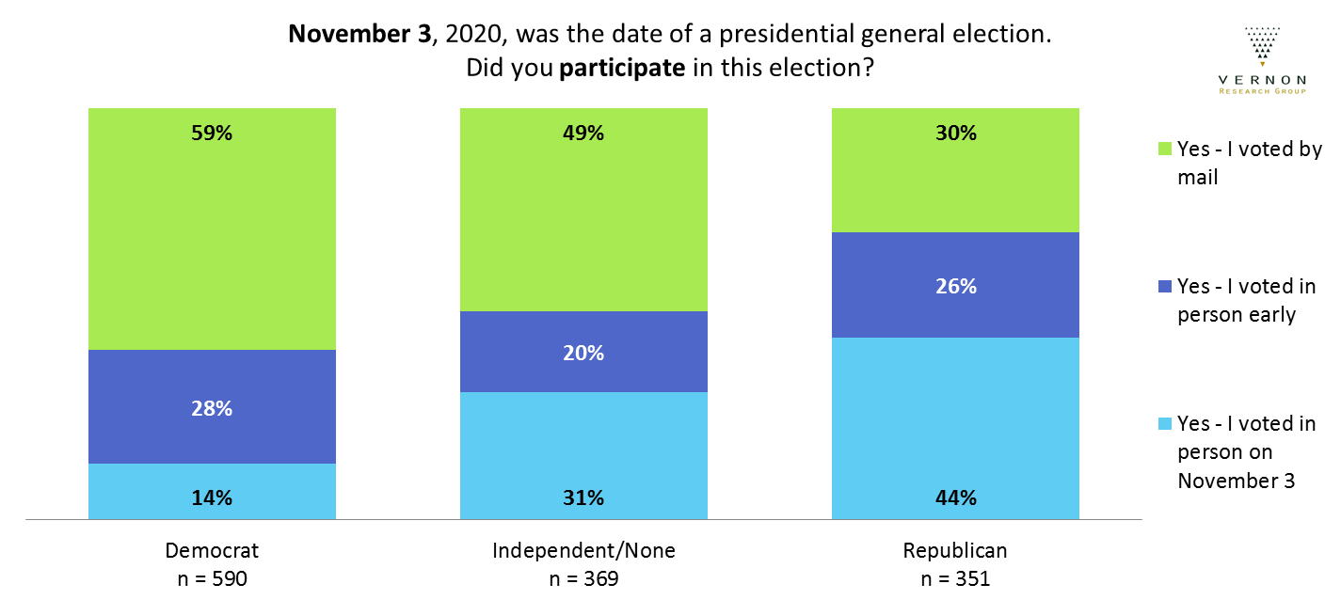
Participation by Political Party
Democrats were more likely to vote by mail and less likely to vote in person on November 3. Independents were between Democrats and Republicans in behavior.
▼ 7

Slide 8
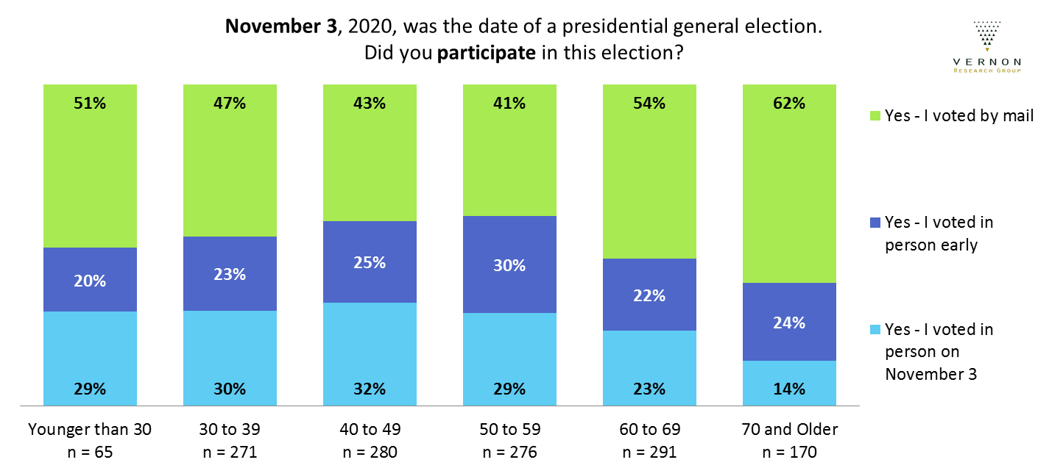
Participation by Age
The oldest IOP members were more likely to vote by mail
and less likely to vote in person on November 3.
▼ 8

Slide 9
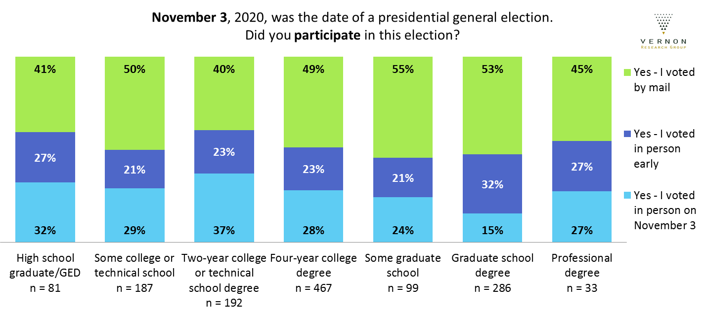
Participation by Education Level
IOP members with a two-year degree were more likely to vote in person on November 3,
and members with graduate degrees were less likely to do so.
▼ 9

